Slide 1
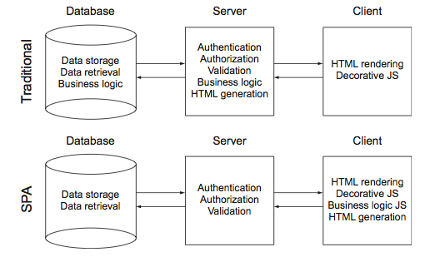
A Single Page Application (SPA) is a web application fitted on a single page and does not reload the page during use to provide better user experience and performance.
Figure: Responsibilities of database, server and client between traditional application and single page application

Slide 2
AngularJS is a well-known open source JavaScript MV* (Model – View – Controller or Model - View - ViewModel) framework developed and maintained by Google. It is the next generation framework designed to give JavaScript developers a highly structured approach to developing cutting-edge web application.
Representational State Transfer (REST) is the stateless architecture based on HTTP protocol to represent the model of how the modern Web should work. REST uses existing technology and protocols of web to access and manipulate resources using verbs (HTTP request methods).
There is a set of verbs for RESTful approach such as GET, POST, PUT and DELETE to
manipulate data in database. Those verbs correspond to traditional CRUD (Create,
Read, Update, Delete) operations in a database or object-relational management (ORM) system. In addition, REST also has 5 categories of responses: general information, a successful request, redirect, error on the client side and error on the server side.

Slide 3
Restful Architecture
Request
Request
Request
Request
HTML
JSP
JSF
Etc
JS
(Controller and Function)
Rest Class
HTTP Methods (GET, POST, PUT, DELETE)
Java Class
Controller
DAO
Database
(MySQL,
Oracle
etc)
Response
Response
Response
Response
Front End
Back End

Slide 4
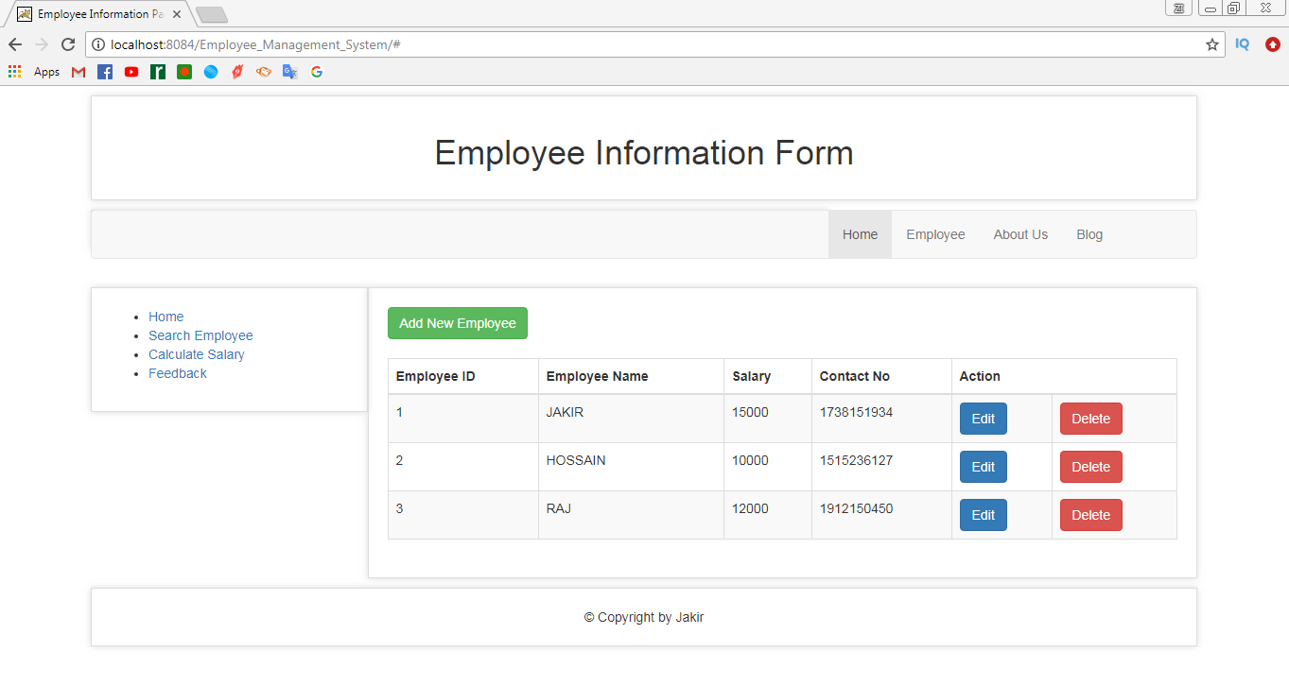

Slide 5
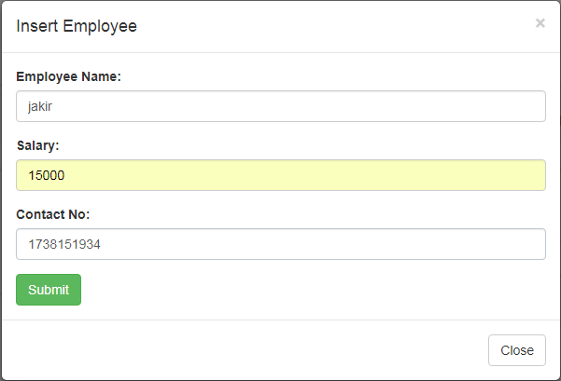

Slide 6
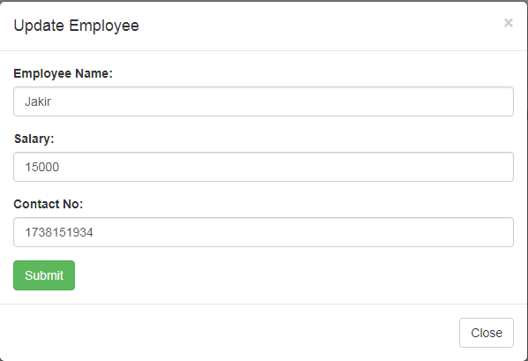

Slide 7
